Slide 1
TANTRIX
R017093H
Notes:
I want to apologise in advance there will be C++ code in the presentation

Slide 2
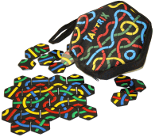
Tantrix?
Tile-based Tabletop Game
Four main versions:
Discovery
Solitaire
Match
Game Pack
Notes:
Tantrix is a tile based tabletop game designed by a man called Mike Mc man away in 1988.
It uses a set of 56 of these tiles which each contain three colour lines from edge to edge.
There are four main versions sold
Discovery
Solitaire
Match
The game pack
The first 3 are smaller puzzle based editions of the game which work in combination with each other
So when im referring to the game ill be referring to the game pack which contains all the tiles.

Slide 3
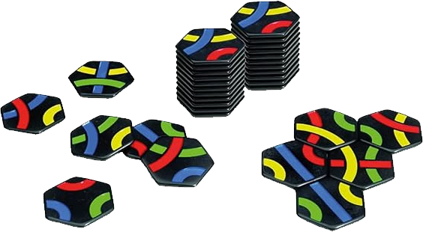
Tantrix?
Each player starts with:
A Colour
Six Tiles
Play rotates clockwise, taking turns to place.
Played until all tiles are used up.
Scored based on longest line or loop.
Notes:
Tantrix is a simple game
With each player holding 6 tiles in their hands and chooses a colour to represent them.
If theres a forced space where a player CAN place a tile, they have to place it first then they can freely place a tile on the board, ensuring every edge matches.
with turn order rotating clockwise.
After placing a tile, the player replaces their tile with a new one from the bag with the game being played until all tiles are used up.
the player with the longest line or largest loop of their colour wins.
Each tile in the line counts as one point, and in a loop, two points. Only the highest-scoring line or loop counts for your score.

Slide 4
Tantrix.
The goal is a standalone desktop application.
Started late so shorter development time.
6 Weeks = 3x2W Sprints
⇒ 1) Planning
⇒ 2) Core Feature Development
⇒ 3) Art/Feel
Notes:
The goal is a standalone desktop application for the prototype.
Developed the prototype using an agile approach which im sure you all understand by now so im not going to cover it
Started later as I swapped projects after coming back after Christmas bc I played the game a lot and wanted to make something like it instead
The shorter dev time meant I ended up splitting it into 3 lots of 2 week sprints.
Planning
Core Features
As much art and feel as a programmer can get

Slide 5
1) Planning
High-Level Features:
Tiles
Tile Container
Tile Connections
  Lines & Loops
Player Hands
Turn System
Placement
Notes:
By clearly defining the game first I found it makes it easier to understand the higher level features im going to want
Ill obviously need some tiles and some sort of container
Then followed with some way to connect them together and some way to determine lines and loops.
Individual player stuff so their hands and a way to choose their own colours
Turn system
And some sort of world placement system.

Slide 6
1) Game Loop
Setup high level flowchart.
Interactions between classes
Progress report.
Notes:
Before starting to design the classes I thought it was probably best to layout how I expect the main game loop to work.
This is to just get an idea of how and when the different classes will interact with each other so that I can figure out what functions will be needed straight away.
It also provides a good idea of how complete the core game loop will be during sprint 2.

Slide 7
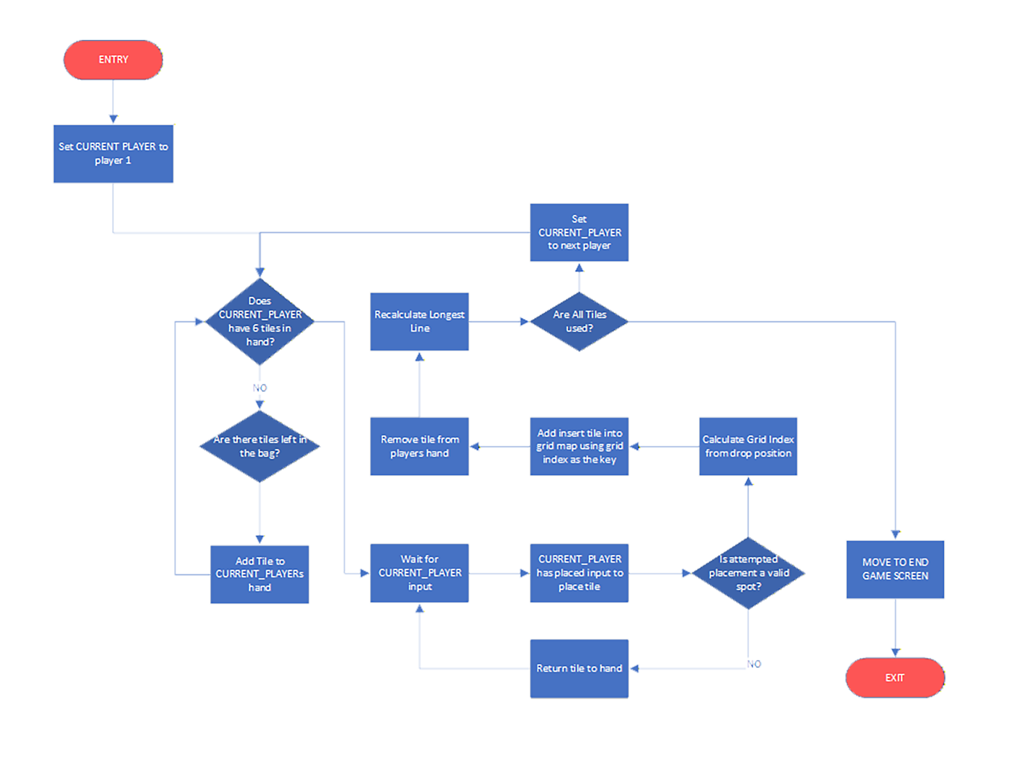

Slide 8
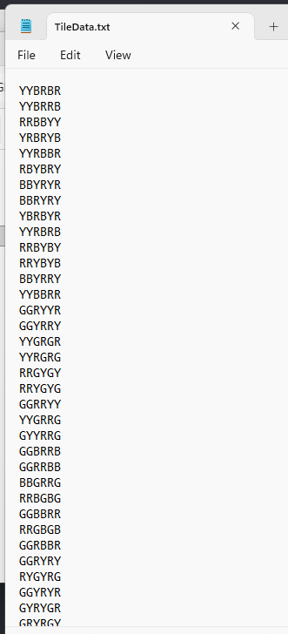
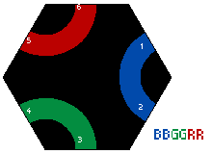
1) Tiles
Tiles are just data.
Stored externally.
Notes:
Now I don’t want to go through every single point on the feature list so I’ll only touch on two of the main things as examples of the class design
The first is the tiles
And the tiles are just chunks of data so we can store them as such as long as they are consistent.
By allocating each colour a character we can just store the edge data as a string and I ended up choosing the top right edge going clockwise.
This also means that creating an storing the tiles can be done using just a text file and can be loaded altered externally.
This is literally the exact file in the game.

Slide 9
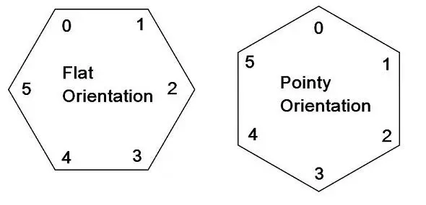
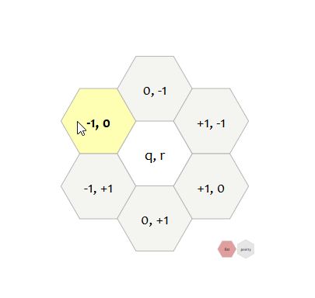
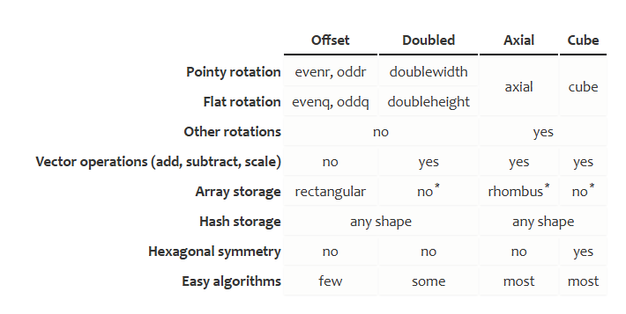
1) Grid
Where the tiles go.
https://www.redblobgames.com/grids/hexagons/
std::unordered_map<Index, int>
Notes:
The tiles have got to go somewhere.
In terms of design I ended up going with the flat orientation over the pointy bc I think it looks better and I had used it in my visualistaion of the data like in the last slide so it was familiar.
It really doesn’t make a difference in the end bc its just a 30 degree tilt for each drawn point.
If you want to build a hex grid yourself this is like the bible
This table is from the website which contains every type of grid implementation and compares them
But using this I chose my implementation which ended up being axial.
I don’t rely on symmetry at all bc things are placed wherever so no cube.
Ill need to find the neighbours through adding offsets onto the grid position which removes the offset coordinates.
Ended up going with axial coordinates bc the three axis approach made more sense to me for the 3 edge pairs of a tile.
The code for the grid is pretty straightforward.
I’ll be drawing the tiles individually just aligned to a grid so ill never actually need to draw the grid so it can all be in data.
The entire thing exists as a wrapped unordered map for O(1) insertion, search and deletion using the grid position as an index.

Slide 10
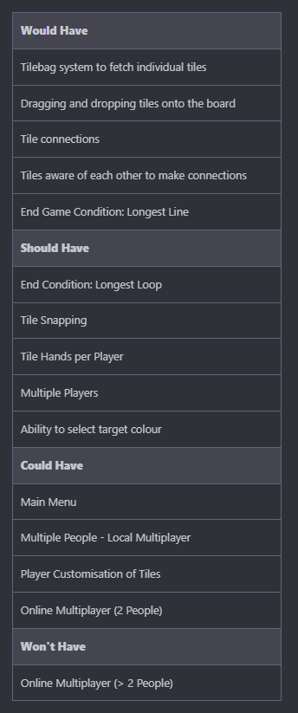
2) Core Development
MOSCOW.
Playable Prototype.
From scratch using SDL3.
- https://www.libsdl.org/
Notes:
From the high level feature list of sprint 1 and some class outlines I setup a simple Moscow board to take into sprint 2
The goal of this sprint is to implement as much of this as possible with the focus of being able to play a full game.
Something that I haven’t touched on yet is that this project is entirely from scratch. As a programmer and more specifically an engine programmer “portfolio” piece to me includes engines and engine features so I thought id be a pretty good challenge to take on.
So the entire thing is written in SDL3 as it covers rendering, input, audio while still letting me build the underlying systems myself.

Slide 11
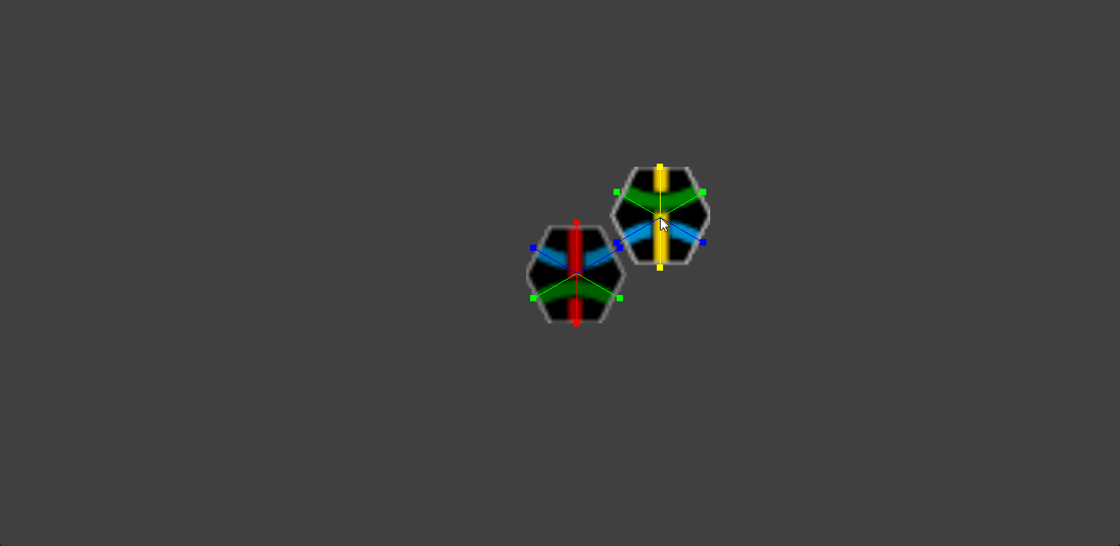
2) Core Development
Tiles, Placement and Rotation
Notes:
I started off with the tile loading and storage before moving onto placement through SDL events.
On a mouse click, performs a point in box check for the encompassing rect of the tile
If it passes its picked up, if not its not.
I also realised after picking them up theres no rotations so I added a keypress to rotate them which just added an offset to the index used when fetching an edge colour
So edge 0 becomes 1 when rotated
But from this I could theoretically play a game.

Slide 12
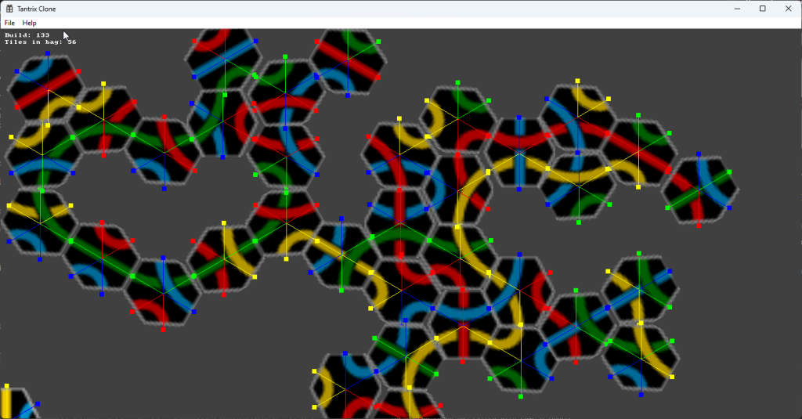
2) First Playtest
Notes:
Which I did and it was pretty fun
However you may notice that theres an issue when you run out of room and icurrently have no way to deal with that

Slide 13
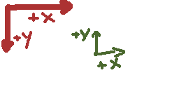
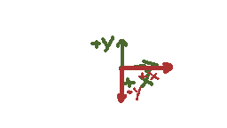
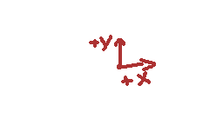
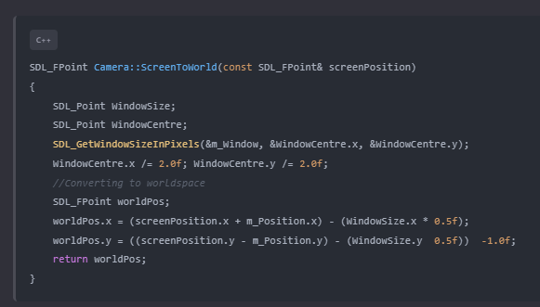
2) World Space
Notes:
To solve the issue created by the playtest I moved every thing into world space which just involves converting from world space to screen space just before im about to draw.
I stuck this in a camera class which has its own position so I can offset within the world.

Slide 14
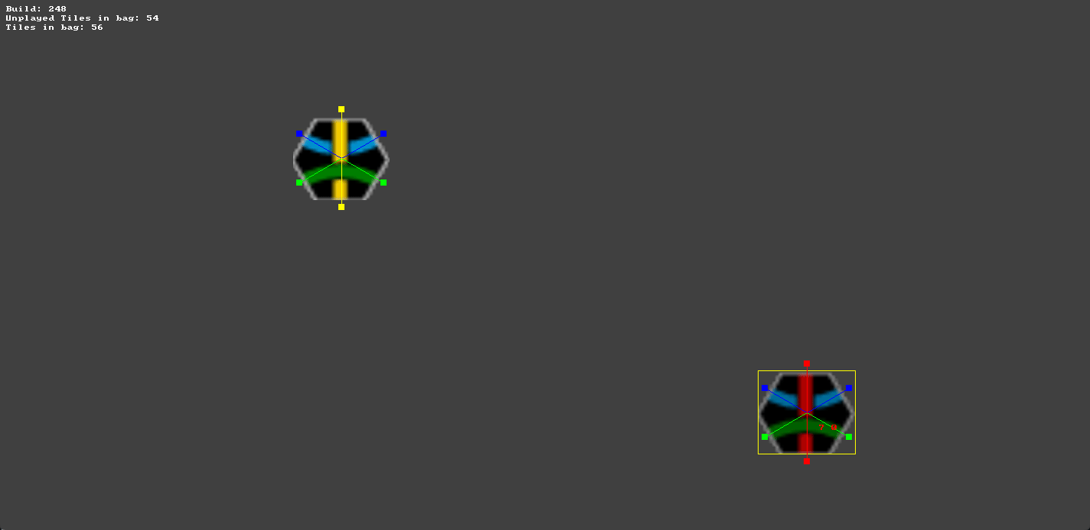
2) Camera

Slide 15
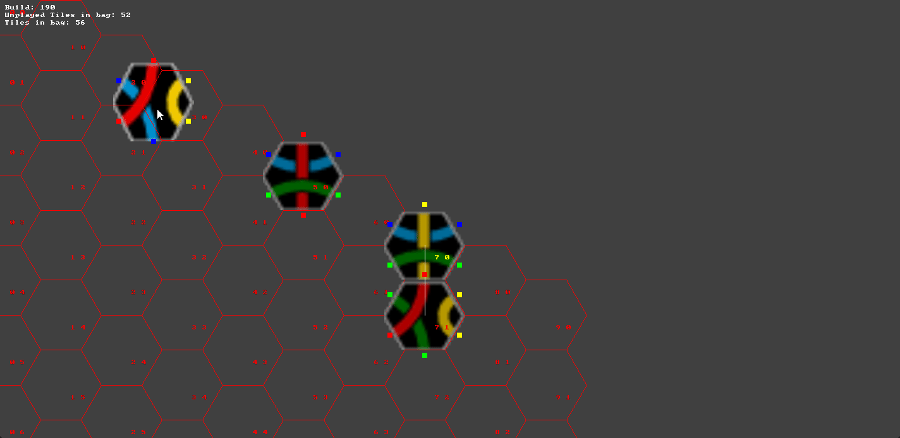
2) Grid
Notes:
Using the stuff I set out earlier it was pretty straightforward to setup the grid, and I know I said I wasn’t going to draw the grid but I needed some debug stuff.
I use the grid to populate an array of neighbours within each tile so they become aware of each other which is used to traverse the graph later to determine the end points

Slide 16
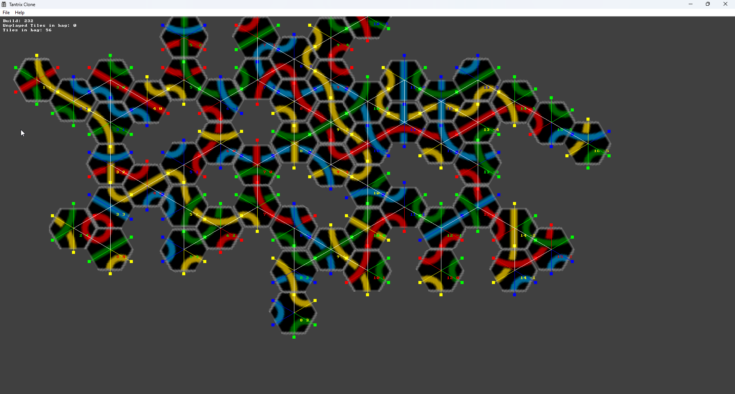
2) Hands
Hands were super simple.
Notes:
Hands were super simple as they are just 2 containers of 6 tiles which are rotated through as the turns change.
If a tile is placed, it's erased from the container (just a vector of indices into tilebag's tile list) and a new tile index is fetched from unplayed tiles and added.
And then draw all 6 tiles for each players hand on their turn.

Slide 17
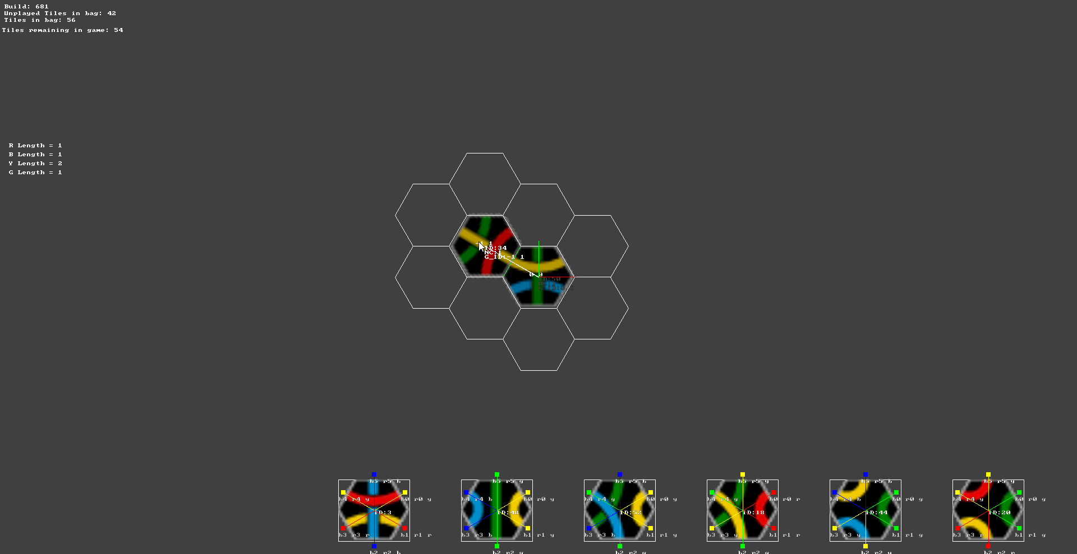
3) Art/Feel
Make it look and feel good. Hopefully.
Work on playtest feedback initially.
Notes:
This is where we are going into sprint 3
The game can be played from start to finish and it tells you who the longest line is as it goes.
After all I am a programmer so this is going to be incredibly painful.

Slide 18
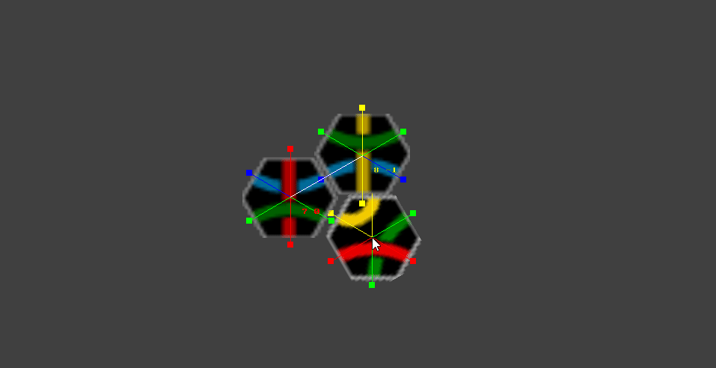
3) Feedback
Some sort of indication or visual feedback. Tile snapping?
Notes:
The most common piece of feedback was that seomtimes findgin a fitting tile could be abit difficult and players didn’t want to put tiles into place without being sure so I implemented a tile snapping system .
While a tile is being held it checks whether theres a valid placement underneath the mouse, and if there is it sets the position of the tile to the placement position rather than it being dragged by the mouse
Then when the check fails again, itll track back with the mouse.

Slide 19
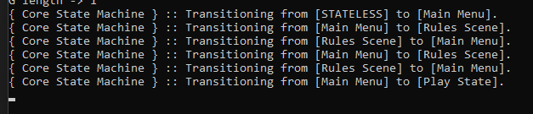
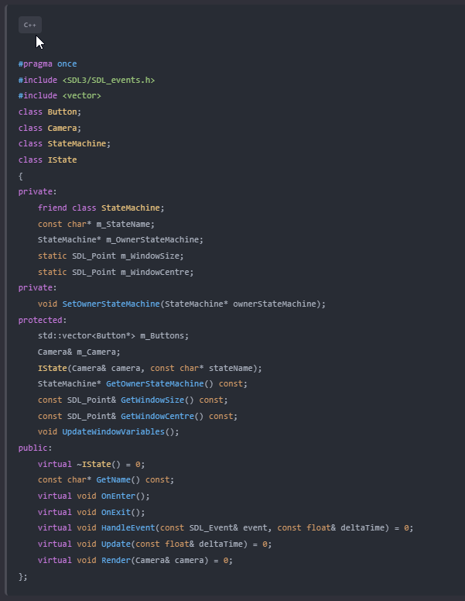
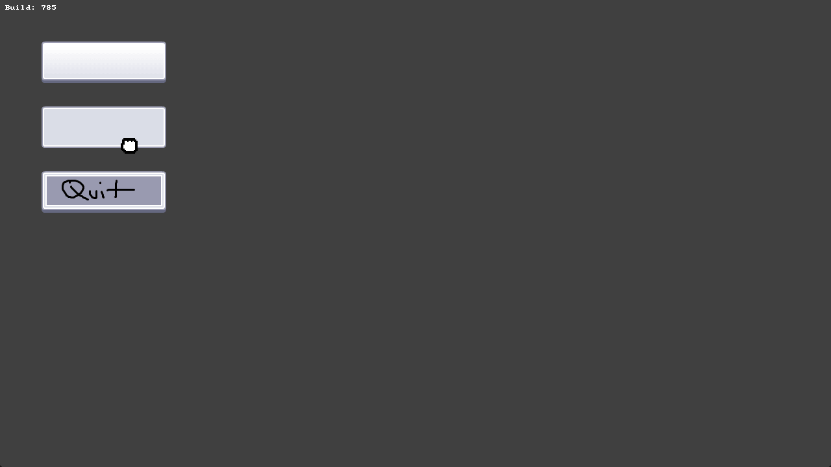
3) State Machine
Creating actual game scenes and buttons.
Notes:
The first thing I implemented was a state machine to wrap the entire game into a series of scenes to add a main menu and a few selection screens.
I ended up using this extremely verbose console output to show the state of the machine as it goes.
I created a system for buttons to traverse the scenes from within the game which utilises a similar system to the picking up of tiles.

Slide 20
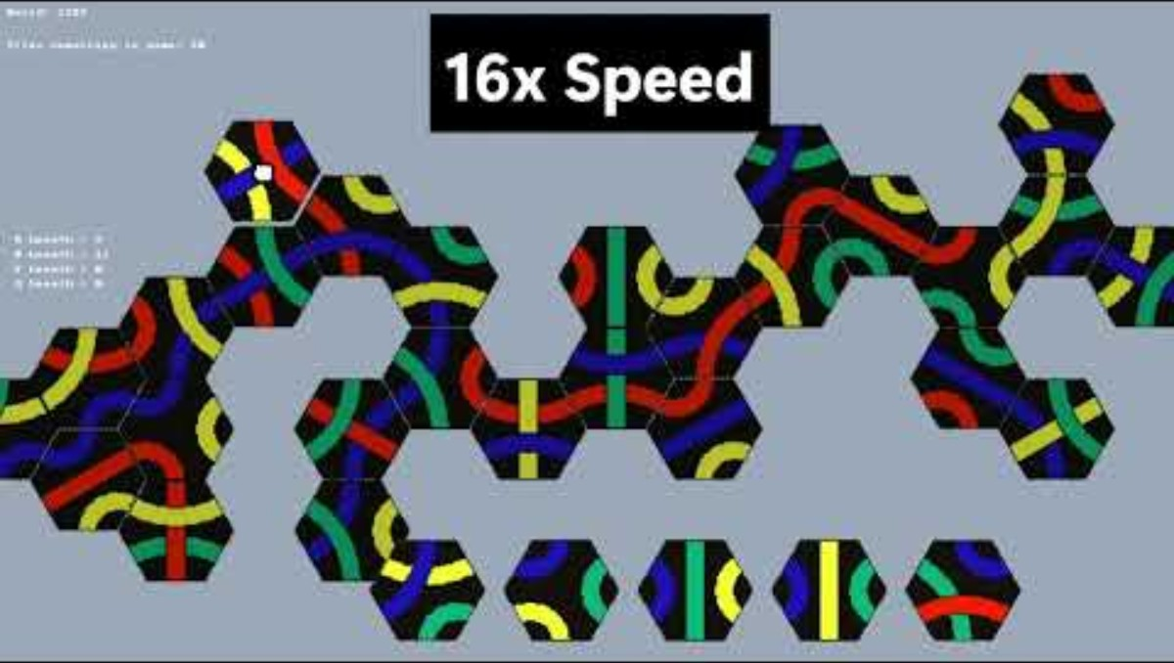
3) Art Style
Notes:
I added a splash screen just as something to maintain continuity with other things that are on my portfolio.
I also added a dedicated transition scene as well as some new main menu artwork just to make it look a little better.
I used gifs to demonstrate the controls rather than just words to better illustrate how to play.

Slide 21
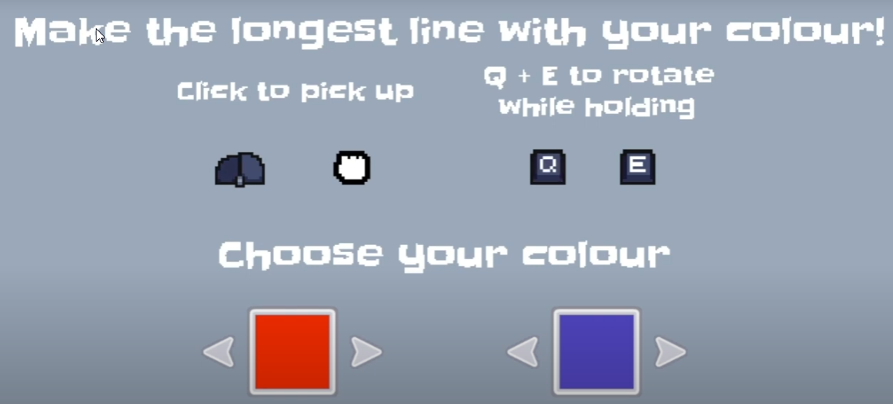
?) Future
More consistency with the art style.
Notes:
In future Id like to be more consistent with the art. While I like this page when compared with the splash and main menu it is so bright so I think finding a better background colour for both this and the game screen would fix this issue but with so many colours going on it felt like a waste of time to do now.

Slide 22

?) Future
Online Multiplayer
Notes:
Id also like to add online multiplayer. The steamworks api is a purely c++ networkgin implenetation and gives access to all of the cool steam things
While ’ve used it before with SDL but I think within the timeframe of this module it was just not feasible and so has been moved to the future. And also giving lectures free keys just to test with sounds like a lot of hassle I don’t want to deal with.

Slide 23
TANTRIX
https://hallamrear.itch.io/tantrix
Notes:
If you want to try the game you can download the exact submission build here.

Slide 24
TANTRIX
Any Questions?
Notes:
If you want to try the game you can download the exact submission build here.

